Slide 1
Handwritten Character Recognition
N Vamsi Krishna(1210313444)
Ch Chanukya(1210313414)
M Hema Prasanthi(1210313434)
Ch Praneeth(1210313417)

Slide 2
INTRODUCTION
Handwriting recognition is one of the most challenging and fascinating research areas in field of image processing and pattern recognition.
It contributes immensely to the advancement of automation process and can improve the interface the interface between man and machine in numerous applications.
Handwriting recognition is classified into two types -
Off-line
On-line

Slide 3
Introduction (CONTD...)
In Off-line recognition, the writing is usually captured optically by a scanner and the completed writing is available as an image.
In on-line recognition, the 2D coordinates of successive points are represented as a function of time and the order of strokes made by the writer are also available.
The online recognition is proven to be superior compared to the offl-line recogniton due to the extra information available.

Slide 4
Introduction (contd...)
In Off-line recognition, the neural networks have been used successfully to yield comparably high recognition accuracy levels.

Slide 5
System requirement specifications

Slide 6
HARDWARE REQUIREMENTS
PROCESSOR
Intel Cor2Duo or Later.
RAM
2GB or More.
HardDisk
Minimum of 20GB.

Slide 7
Software requirements
Operating System
Windows 7 or Later.
Development Tools
MATLAB 2010 or Later.

Slide 8
Functional requirements
Input :
Scanned Image consisting of Handwritten Characters
Dataset of for Training the neural network
Trained neural network for recognition of characters.
Output :
The system needs to display the recognised characters from the input image(if)

Slide 9
Non-functional requirements
Flexibility : The system provides an easy to use interface for uploading the input image.
Availability : The system will display the characters only if image contains any characters in it.
Learn ability : The system should be easy to learn and use.
Performance : The system should recognise the character with at least an acceptable accuracy of 65-70%.

Slide 10
Process
Image Acquisition
Image Segmentation
Preprocessing
Feature Extraction
Classification and Recognition

Slide 11
Image Acquisition
Input images to the system is obtained by scanning the written characters by using a scanner.
These images are resized to 120 x 180 size and provided as input to the system.

Slide 12
Image segmentation
In segmentation stage, an image of sequence of characters is decomposed into sub-images of individual characters from the input image.
By segmentation, we can determine the number of characters present in the image(approximately).
Image segmentation is done by the assumption that each character is present in it’s own boundary of 120 x 180 size.
So an image of 3 characters would be of size 360 x 180.

Slide 13
PREPROCESSING
It is a series of steps which enhances the image rendering it suitable for feature extraction.
Preprocessing includes -
Binarization
Edge Detection
Dilation
Filling

Slide 14
Binarization
In this two operations are performed on the input image-
First,Image is converted into grayscale image.
Second,Grayscale image is converted into Binary image using Global Thresholding technique.

Slide 15
Edge Detection
In this detection of edges in the binary image is done using sobel technique.

Slide 16
Dilation
It is a mathematical morphological operation.
The basic effect of dilation is to gradually enlarge the boundaries of regions of foreground pixels. Thus areas of foreground pixels grow in size while holes within those regions become smaller.

Slide 17
Filling
A hole is an area of darkness surrounded by white pixels.
In this all such holes are filled.

Slide 18
Feature extraction
In this stage, the features of characters that are crucial of classifying them at recognition stage are extracted.
It is an important stage as it’s effective functioning improves the recognition rate and reduces the misclassification.
Diagonal based feature extraction along with Vertical and Horizontal is implemented for extracting features from images.

Slide 19
Feature extraction
Each character image of size 120 x 180 is divided in 54 equal size zones each of size 20 x 20 pixels.
The features are extracted from each zone pixels by moving along the diagonals of it’s respective 20 x 20 pixels.
Each zones has 39 diagonals and the foreground pixels of each diagonal is summed to get a single sub-feature.
From each zone 39 sub feature values are obtained which are averaged to get a single feature value and placed in corresponding zone.

Slide 20
Feature extraction
This process is repeated for all zones.
There could be some zones whose diagonals are empty of foreground pixels and the feature values for such zones are zero.
54 features are obtained from the 54 zones using diagonal based feature extraction.
In addition to this 9 and 6 feature values are obtained by averaging the feature value in zones rowwise and columnwise.
Finally we obtained a total of 54+9+6 = 69 feature values from a single character image.

Slide 21
Training and recognition
This stage is the decision making part of the recognition system.
It uses features extracted in the previous stage for training and recognition.
A feed forward backpropagation neural network having the architecture 69-100-36 is used for performing the recognition.
The number of neurons in the hidden layer is obtained by trial and error.

Slide 22
Training and recognition
The network training parameters are:
• Input nodes : 69
• Hidden nodes : 100
• Output nodes : 36 (26 alphabets, 10 numerals)
• Training Algorithm : Levenberg-Marquardt backpropagation
• Performance Function : Mean Square Error
• Training epochs : 50
• Validation Checks : 6

Slide 23
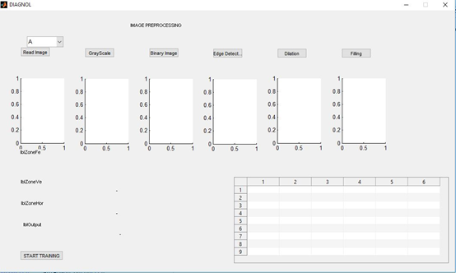

Slide 24
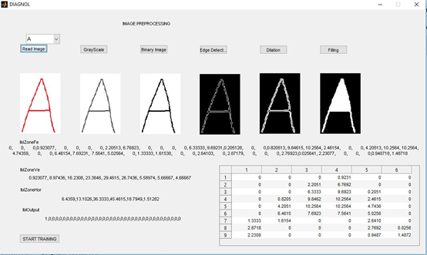

Slide 25
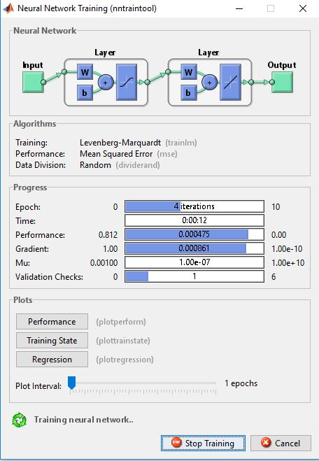

Slide 26
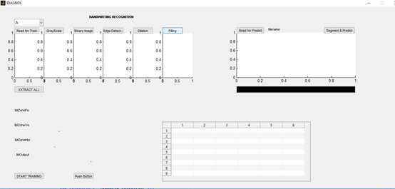

Slide 27
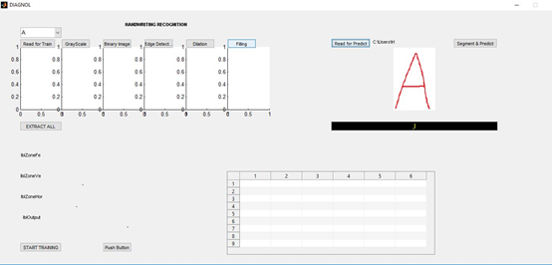

Slide 28
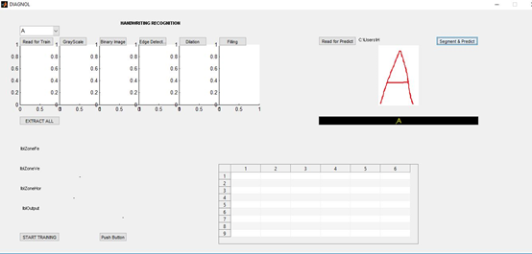

Slide 29
applications
There are several applications for Offline Handwritten Character recognition.Some of them are :
Bank processing
Document reading
Postal address recognition
And many more when combined with other systems.

Slide 30
Future work
The implemented system has some flaws which can be corrected in future work.
Recognition is lowercase letters and symbols.
Recognition of other languages apart from english.
Improving the training dataset to get better accuracy.
Improving the segmentation limits and image size bounds.

Slide 31
Thank you

